Slide 1





ELEGANT MANGOES DATA ANALYTICS
App acquisition recommendation report for App TRADER
Rachel Hertel, Trey Bourgois, Tim Pearson, Scott Boyer and Yared Gabre
Elegant Mangoes
Acquire Better- Acquisition and Merger Consultants

Slide 2
App Acquisition Strategy
Elegant Mangoes working with AcquireBetter has put in place 5 factors to consider for acquisition..
The rationale behind the acquisition
Impacts on financial
Trends and history
The Ongoing Cost of Running the app
Legal Issues and Baggage

Slide 3
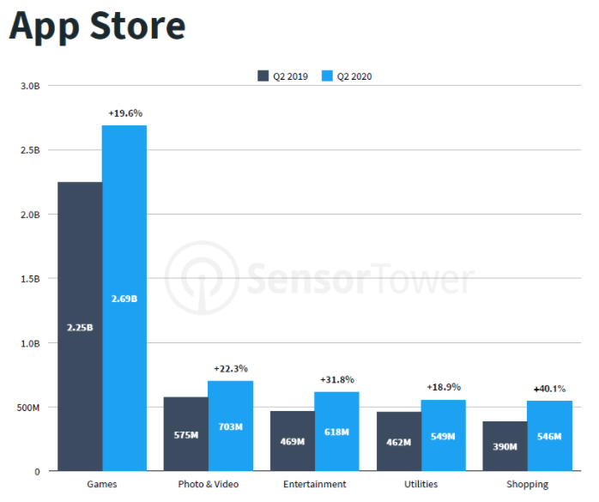
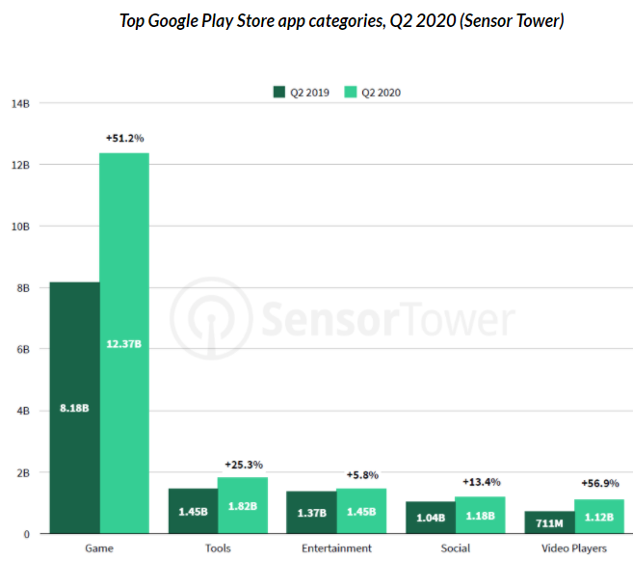

Slide 4

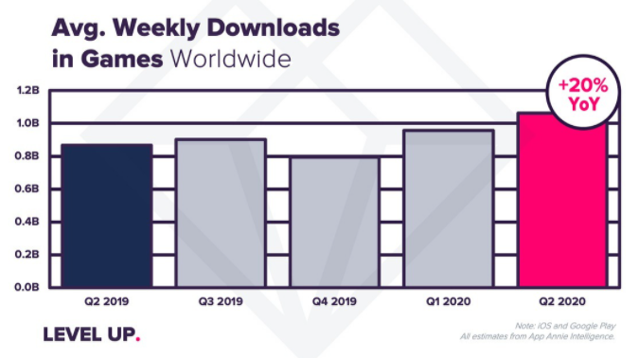
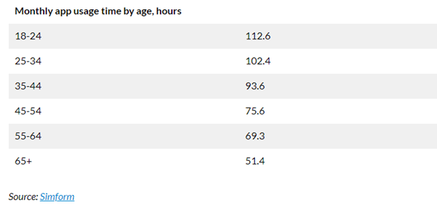
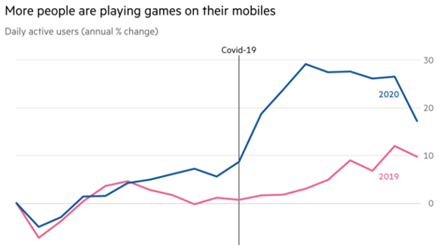
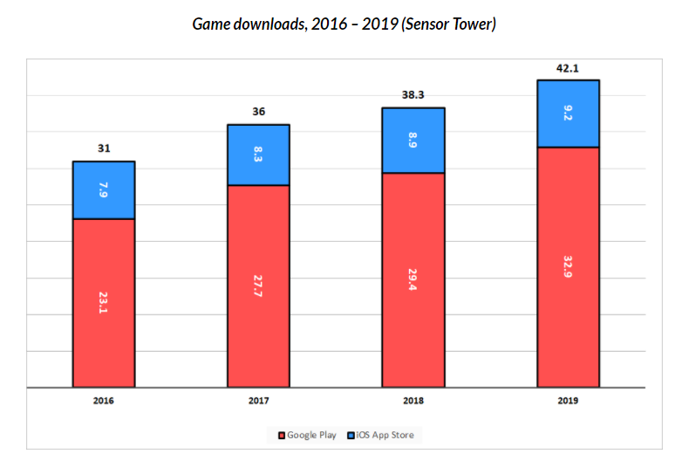

Slide 5
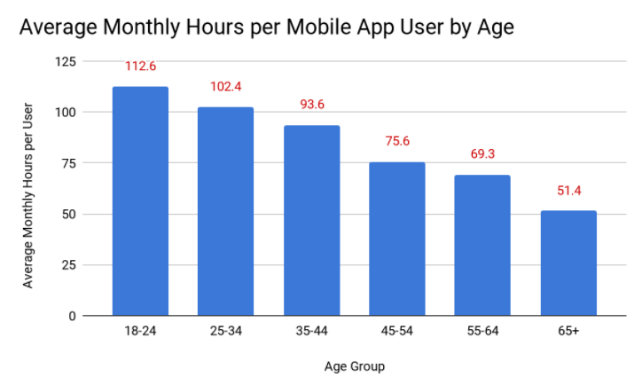
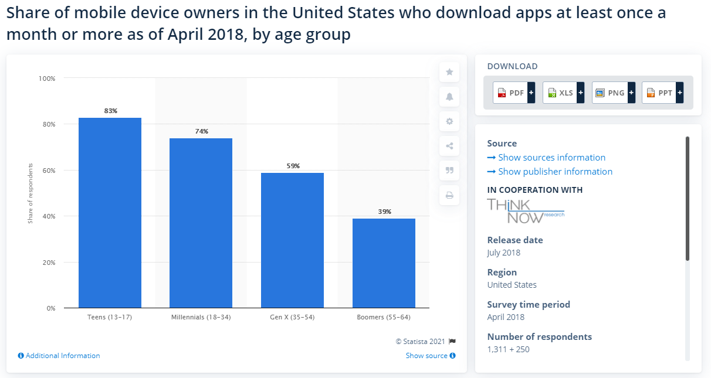

Slide 6
Final Report
Based on the thorough analytics we did and the report we got from Acquire better ( a third-party company specialized in merger and acquisitions) we came to the conclusion and recommend the following top 10 apps to acquire
The app longevity
App not involved on a security breach that was not reported on time
Does not support terrorism,

